Slide 1
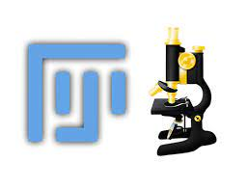
Download materials from:
https://github.com/JamesCrichton/FIJI_Workshop
Green “Code” button, Download ZIP, extract files
Then go here for exercises and more information:
https://image-analysis-workshop.github.io

Slide 2
Bioimage Analysis in Fiji
James Crichton
Experimental Officer (Imaging and Image Analysis)
@TheRILD

Slide 3
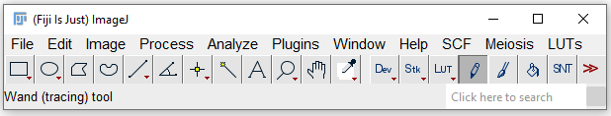
What is ImageJ??
Compact, Java-based image processing program developed by the NIH
First released 1997
Open source
Great for developing and sharing plugins and scripts
Huge user base
Active and supportive community
Fiji released in 2012, has 31,465 citations

Slide 4
Outline
Topics:
What is an image?
Image processing, making figures
Recording processes and starting to code
Calculating quantitative measurements
Loops and conditions

Slide 5
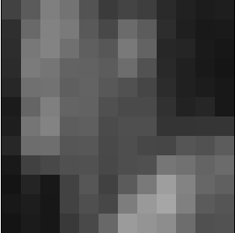
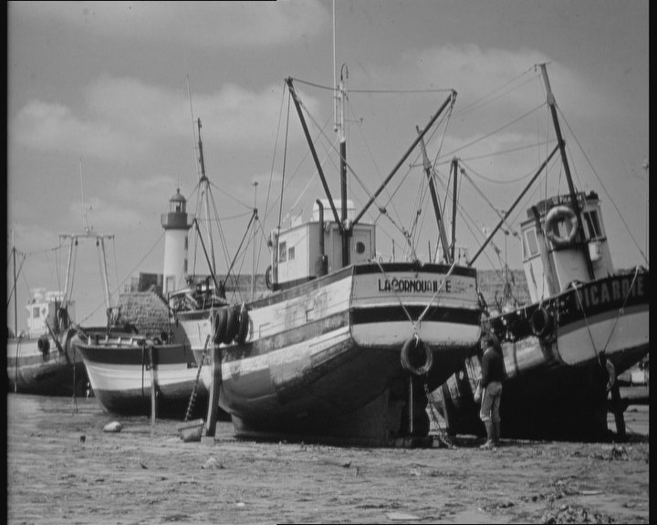
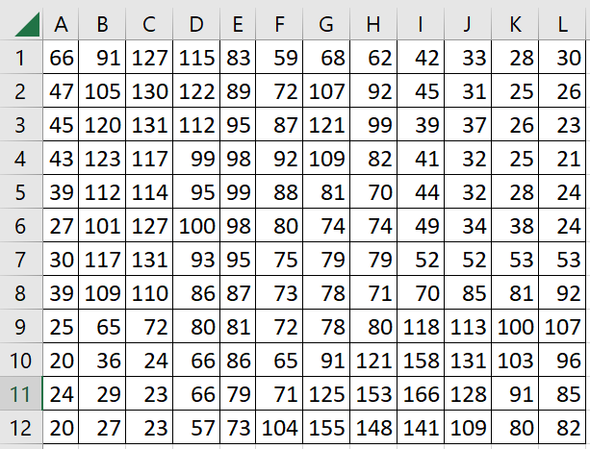
Images are arrays of values

Slide 6

Bit Depth
Image values exist in a range referred to as the “bit depth”
Numbers fundamentally are binary (0 or 1)
1bit = 2¹ i.e. 2 values
8bit = 2⁸ i.e. 256 values
16bit = 2¹⁶ i.e. 65536
Etc

Slide 7
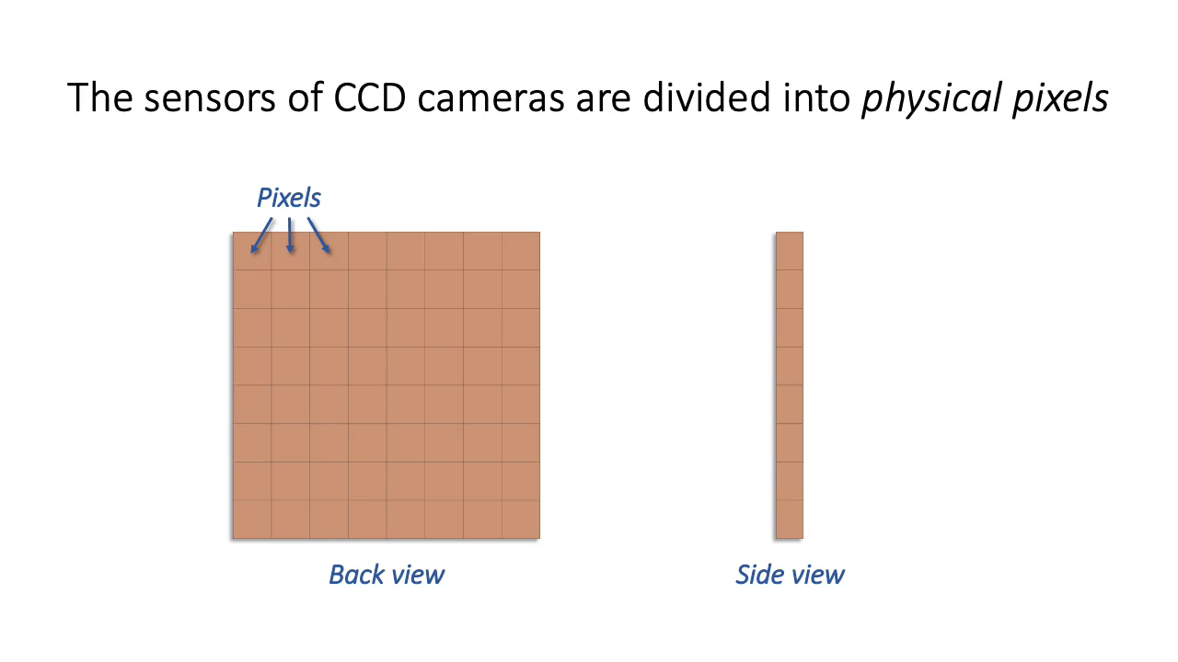
How are values generated?
Pete Bankhead – Introduction to Bioimage Analysis

Slide 8
Factors affecting pixel values
Time spent detecting photons (exposure time)
Longer exposures result in higher values
Numerical aperture
Higher NA can collect more photons, resulting in higher values
Detector sensitivity (gain)
Higher sensitivity increases detection of photons
(Also increases detection of noise)
Pixel values are rarely meaningful in isolation.
Need to compare between images and capture with identical parameters.

Slide 9
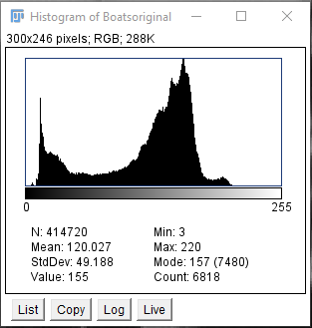
Image histogram
Image values presented as frequencies
Here, 0 is white and 255 is black

Slide 10
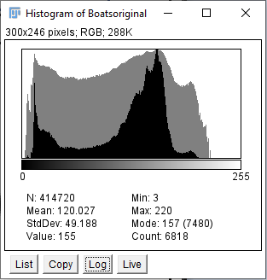
Dynamic Range
Max Value
The difference between the highest and lowest recorded values in an image
To maximise the potential of a microscope and build the most informative dataset
Optimise by considering how you set your capture parameters
Short exposure: low dynamic range. Little info on intensity variation in samples
Long exposure: risk of over saturating image and losing linear relationship between values

Slide 11
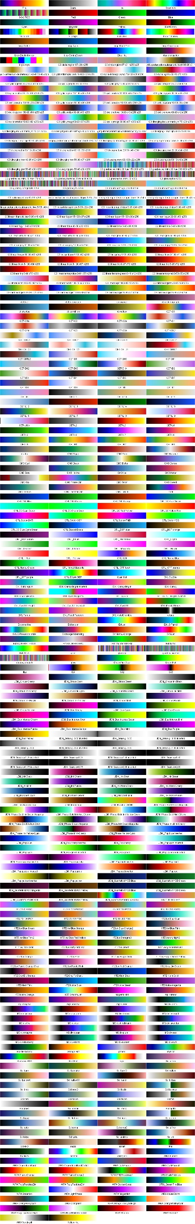
Lookup tables (LUTs)
Fluorescence images have no inherent colour (greyscale)
Visualise the values using different pallets (doesn’t change the values)

Slide 12
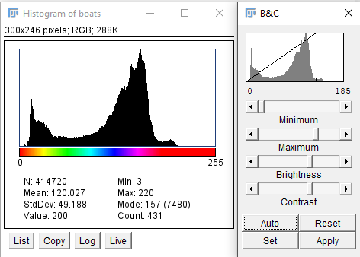
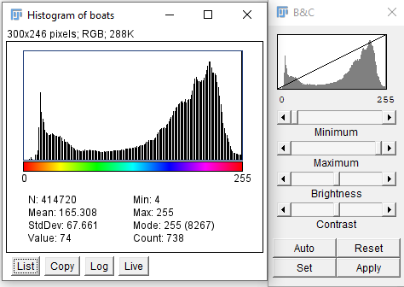
Adjusting Appearance
Adjust appearance only
Adjust appearance and values by Applying (“clipping”)

Slide 13
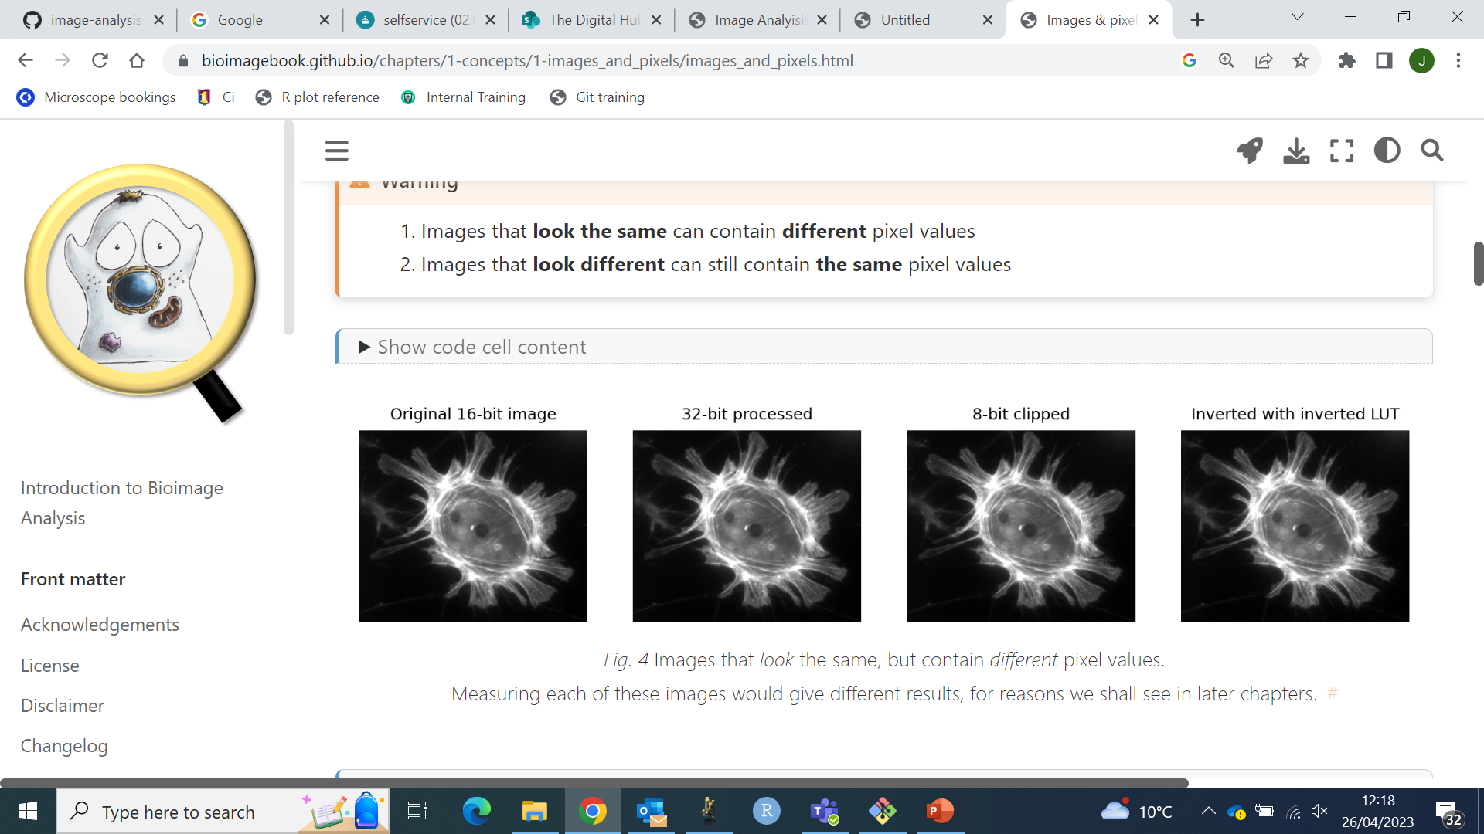
Images can look identical but contain different values
Pete Bankhead – Introduction to Bioimage Analysis

Slide 14
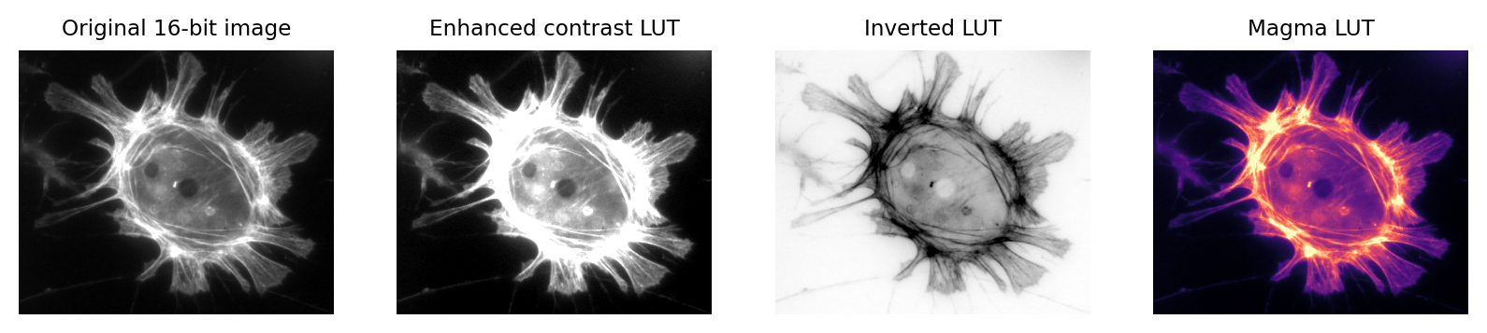
Images can look vary different a contain the same values
Pete Bankhead – Introduction to Bioimage Analysis

Slide 15
Other Image Types
RGB Images
RGB images are inherently coloured
3 values per pixel (red, green, blue)
Multi-dimensional images
Multiple greyscale images stacked together
Channels (multiple stains)
Z-position (3D)
Time (time-series)
Location (multi-point)

Slide 16
Metadata
Information relating to an image, saved behind the scenes
Typically very detailed
When was it taken
Microscope used
Filters
Exposures
Other capture settings
Objective
Image scale (px/um)
Bits of this exhaustive list of information can be very useful.
Always preserve a raw copy of your images with this data.

Slide 17
Page 1 Exercises

Slide 18
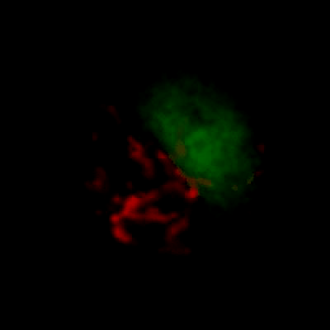
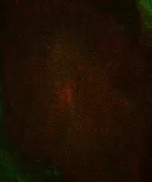
3D Images
Max Intensity Projection
Z-stack
Chosen Slice
3D images can be useful for analysis but less convenient for visualising
Take a slice
Project signal:
E.g. Maximum intensity projection (MIP)
Different methods depending on what you want to show

Slide 19
Scale Bars
Essential for publication
Necessary for calibrating any measurements
Scale of image is the relationship between pixels and real distance (e.g. μm)
Determined by camera and the objective lens used
Scale is typically recorded in the image metadata

Slide 20
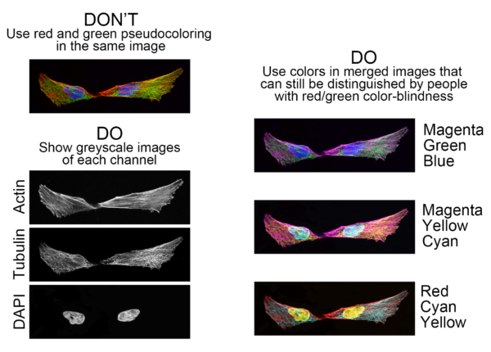
Showing Merged and Separated Channels
It’s often useful to show merged and separate channels
Consider your choice of lookup tables carefully
https://www.ascb.org/science-news/how-to-make-scientific-figures-accessible-to-readers-with-color-blindness/

Slide 21
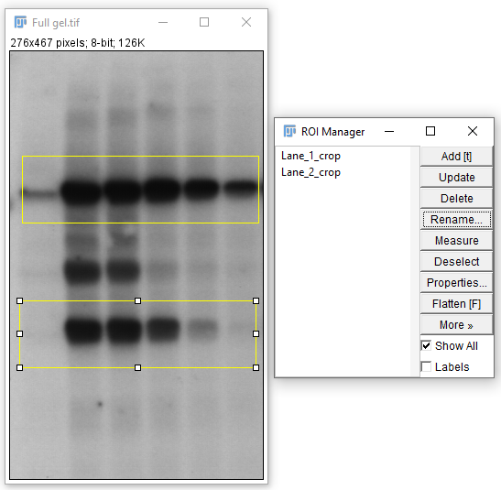
The ROI Manager
Enables you to record coordinates of regions of interest for reference and reuse
This tool is also very valuable in analysis

Slide 22
Interpolation when rotating
Think about what rotations are doing to your image data!

Slide 23
Exercises Page 2

Slide 24
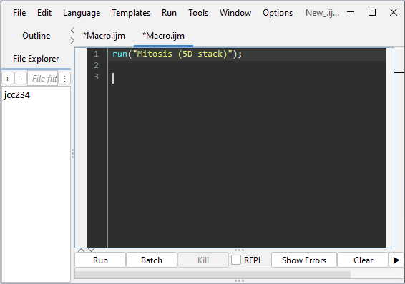
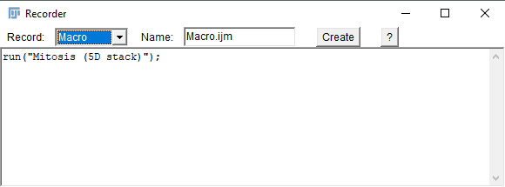
The Recorder
Records actions and displays code to repeat them
Great way to start coding and automating your tasks
Default language is ImageJ macro

Slide 25
Writing Code in ImageJ
End a command with ;
Write comments using // to “comment-out” so it’s not read as code
Annotate your code so you and others understand it
It might make sense when you write it, but no 6 months later!
Data types:
String
“Anything in quotation marks. Even numbers! 01234……”
Number
No quotation marks. These are recognised as numbers and you can do maths
Array
A list of numbers or strings (or both – this can get confusing though so try to avoid)
Variables:
Arbitrary names you can give to things to recall them later e.g.
Name=“James”;
print(Name);
James

Slide 26
Modifying Strings
Add variables to strings
Name=“James”;
print(“My name is ”+Name);
My name is James
Common operation in Fiji, to modify commands e.g.
Img_1=“Image_1_filename.tiff”;
Img_2=“Image_2_filename.tiff”;
open(“C:/Desktop/”+Img_1);
open(“C:/Desktop/”+Img_2);

Slide 27
Exercises Page 3

Slide 28
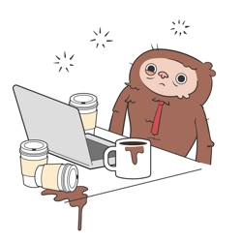
Adding plugins
Help > Update > Manage update sites
Select:
CSB Deep
Stardist
SCF MPI CBG
IJPB-plugins
Apply changes
Restart Fiji

Slide 29
Background subtraction
Original (118x118)
Subtracted 19
Rolling ball (40px)
Background signal will exist in images
May vary within individual images
Will vary between images
This background will influence the values recorded for your real signal
Can try to remove background to normalise intensity values
2 main methods to correct
Manual subtraction: measure the background e.g. average signal over an area, and subtract from the total image signal
“Background subtraction” function: calculates average background in a “rolling ball” and subtracts them.
Particularly useful for uneven background
Keep any correction technique consistent
NB. Macros enable you to document how work was done, as well as repeating it.

Slide 30
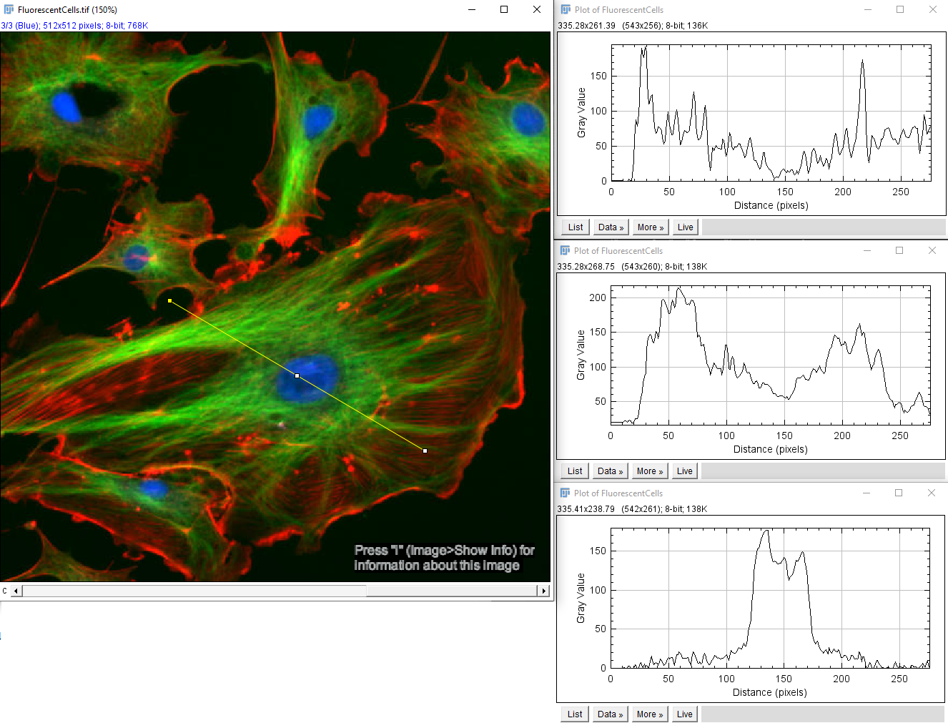
Plot profile (Ctrl+K)

Slide 31
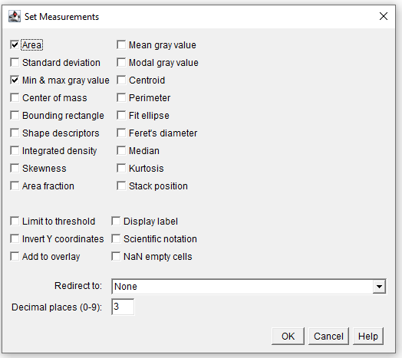
“Measure”
The values calculated by the Measure function can be specified separately in Set Measurements
Can also specify measurements to be taken from another image e.g. a different channel

Slide 32
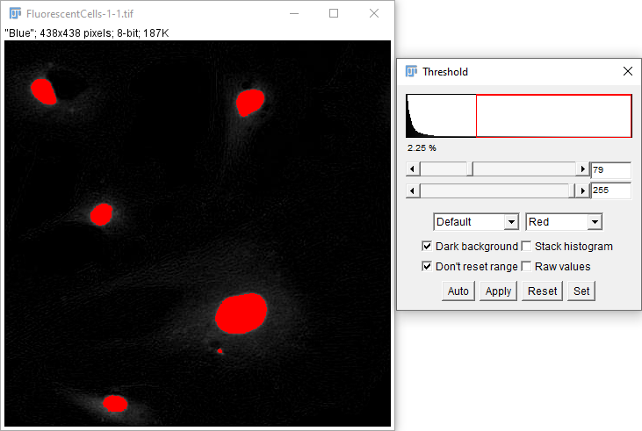
Image Segmentation
Original
Thresholding
Binary Mask
For counting objects and measuring relationships between them we need to segment
Achieved by thresholding
Classification of pixels as either:
0 - Not what you’re interested in
1 - The thing you’re interested in (255 in 8bit)
This is a binary classification and can be shown as a binary mask

Slide 33
Thresholding
Manual
Signal within a range you specify
Automatic
Range specified by an algorithm
Lots of options (see what works for you)
Otsu particularly popular

Slide 34
Noise
Noisy Image
Auto-Segment: Otsu
Images captured always feature some degree of noise from the camera
Other small unwanted features also commonly exist in microscopical images
This signal can impair the ability to segment images

Slide 35
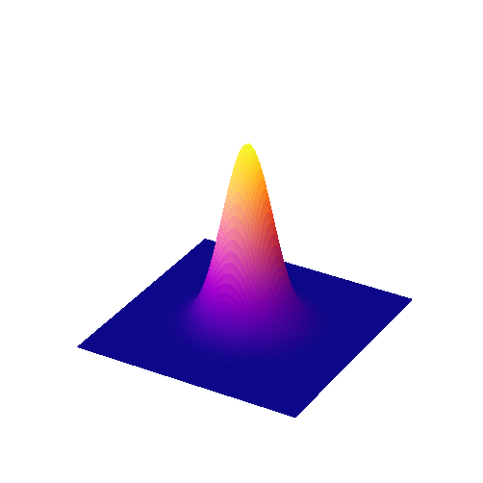
Filtering
Noisy Image
Gaussian Filter
Auto-Segment: Otsu
Filters can help remove noise (and have other uses)
Pass a window over the image, mathematically processing pixel values dependent on neighbouring values
Gaussian filter commonly used
Weighted filter smooths signal
Read more here:
https://bioimagebook.github.io/chapters/2-processing/4-filters/filters.html

Slide 36
Binary Operations

Slide 37
Binary Operations
Dilation + Erosion can make edges more uniform
Erosion + Dilation can separate objects

Slide 38
Watershedding

Slide 39
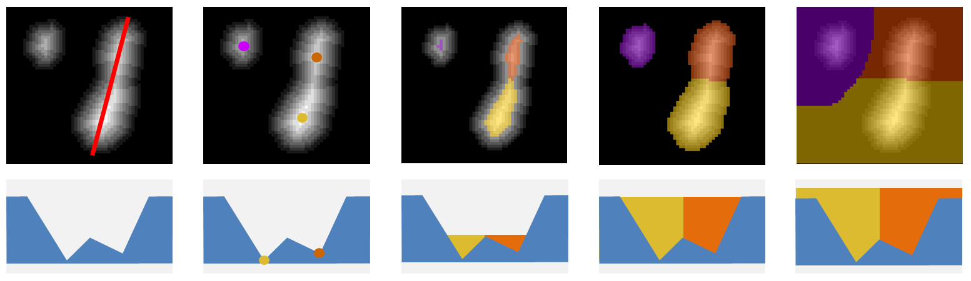
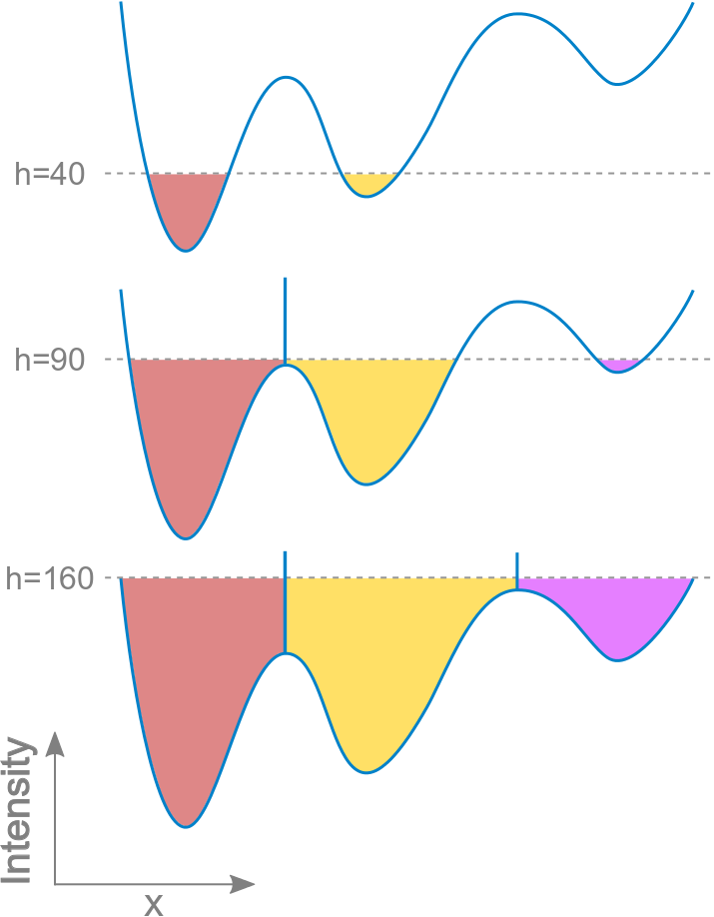
Watershedding
Separate adjacent objects
Consider the image intensities as an inverted mountain range
Furthest points from the edge are the valley bottoms
Where would the pools join if filled with water?
There are several variations on this

Slide 40
Labelmaps
Images can be used to represent regions classified by segmentation
Values no longer reflect the signal intensity, but rather a classification
Binary images (0/1 i.e. yes/no)
Labelmaps (a range of unique integers)
Each number is a unique ID for each segmented object

Slide 41
Measure binary objects with “Analyze Particles”
Now that your image contents have been segregated, their features can be measured

Slide 42
Page 4 Exercises

Slide 43

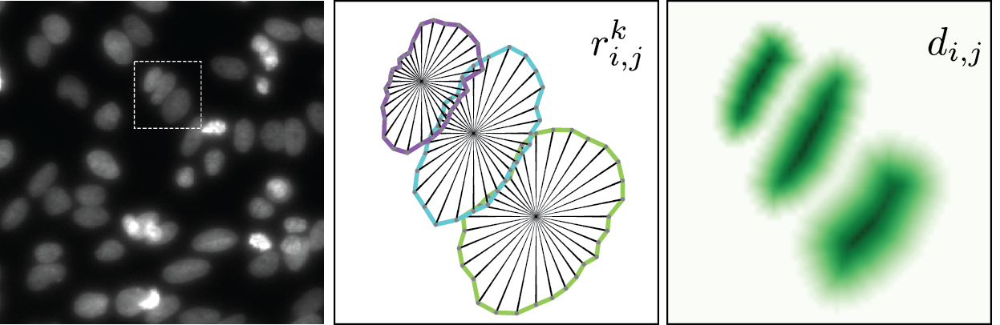
Machine Learning
Install CSB Deep and Stardist in ImageJ Updates
Pretrained neural network
Works very well with to segment round objects (nuclei, round cells)

Slide 44
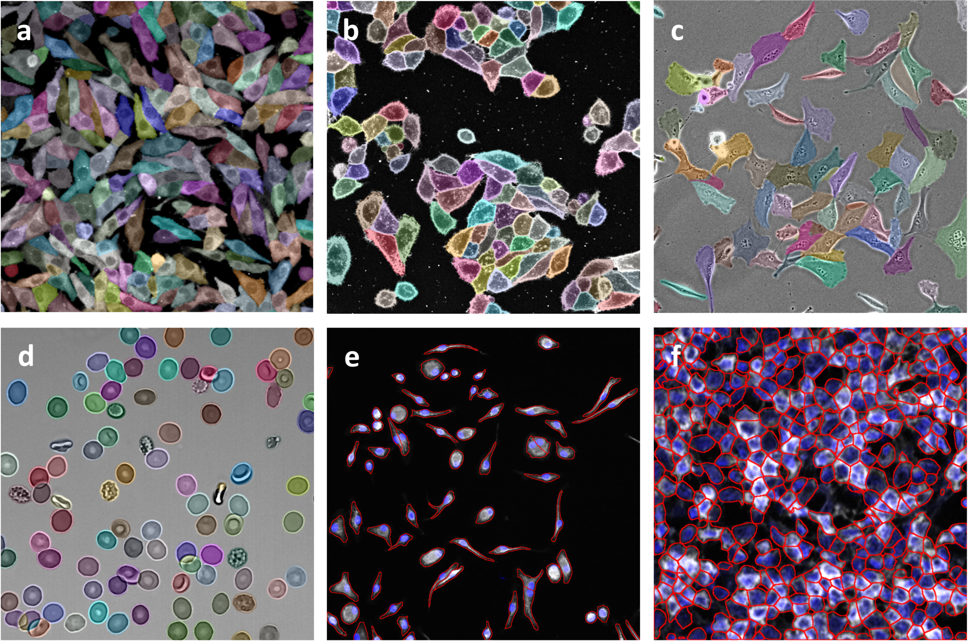
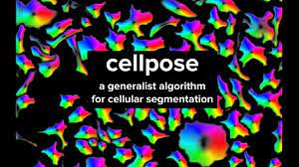
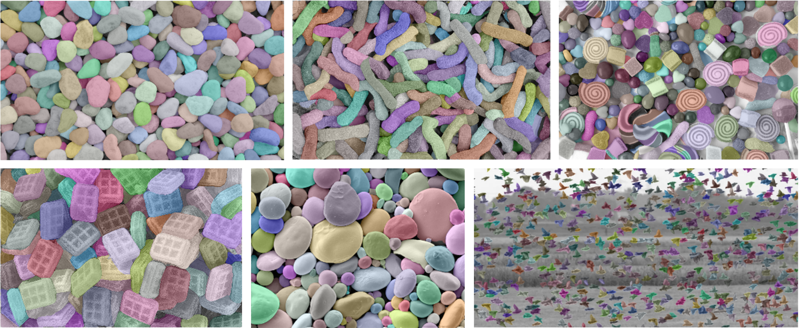

Slide 45
Continue Page 4 Exercises

Slide 46
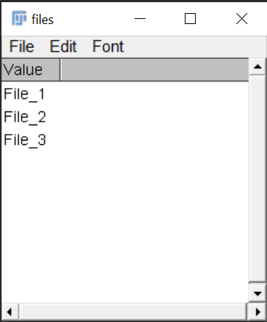
Arrays
files=newArray("File_1","File_2","File_3");
Array.show(files);//displays array
Arrays contain a list of values
These can be numbers, strings or both

Slide 47
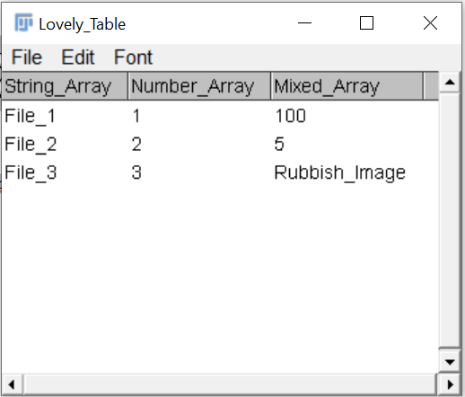
Arrays to tables
String_Array=newArray("File_1","File_2","File_3");
Number_Array=newArray(1,2,3);
Mixed_Array=newArray(100,5,"Rubbish_Image");
//Combine to make a table
Table.showArrays("Lovely_Table", String_Array, Number_Array, Mixed_Array);
Really useful for outputting bespoke data

Slide 48
Loops
NO
Initialise
Code block
Last Iteration?
YES
End
Looping is extremely useful for processing batches of data
Loops iteratively move through arrays e.g.
Batches of images in a folder
Lists of values for mathematical analysis

Slide 49
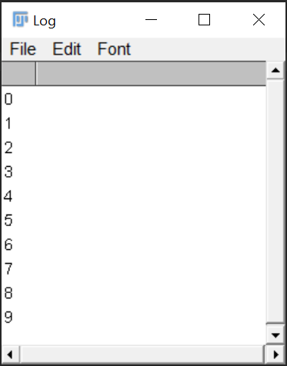
Loops in Fiji
Initialise loop:
i is an arbitrary name for a variable
i=0 is the starting value (“initialization”)
i<10 keep going while value of i is <10 (“condition”)
i++ add one (“increment”)
for (i = 0; i < 10; i++) {
print(i);
}
Code block:
Contained between {}

Slide 50
Conditional Statements (if/else)
Question
YES
Code block
End
NO
Yes/No expression (“Boolean”)

Slide 51
Conditional Statements (if/else)
Question
YES
Code block
End
NO
Different
Code block

Slide 52
Conditional Statements (if/else)
x=2;
if(x>1){
print("x is bigger than one");
}
else{
print("x is not bigger than one");
}

Slide 53
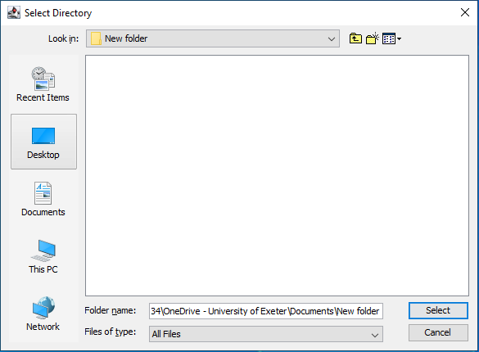
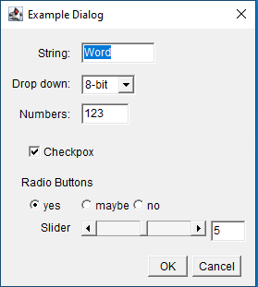
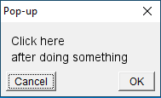
Dialogues
Popups for manual intervention

Slide 54
Page 5 Exercises

Slide 55
Be Critical!!
Garbage in, garbage out
Make sure you capture good images
Make the most of the dynamic range
Check how you pipelines are performing, this isn’t magic
You must be the expert, judging how well analyses are performing

Slide 56
Imaging Community
“Imaging Forum”
Building a bioimaging community at UoE
Technical and research seminars
Discussion and skill sharing
Email me to be added (j.c.crichton@exeter.ac.uk)

